Slide 1
Studying state-of-the-art HTAP systems
- Satya Sai Bharath Vemula
- Rwitam Bandyopadhyay
- Shubham Pandey
Milestone 1

Slide 2
Table of Contents
Introduction (~4 min)
History of OLAP & OLTP
Challenges of HTAP Systems
Architectural taxonomy of present HTAP Systems
Oracle Dual-Format Database (~8 min)
SAP HANA (~8 min)
TiDB (~9 min)
Project Plan (~1 min)
Notes:
Quickly going through the agenda for today.
We will go through a brief introduction of what HTAP systems are, the challenges involved, and some common HTAP architectural styles.
We will then cover 3 DB systems today and see how they achieve HTAP.

Slide 3


Introduction
HTAP
OLTP
OLAP
Online Transaction Processing
Online Analytical Processing
ETL
Source: https://phoenixnap.com/kb/oltp-vs-olap
Notes:
To really understand the HTAP systems, its important to discuss how DB systems evolved and motivate why we need HTAP now.
OLTP systems are insert or update intensive, first made operational by IBM for American Airlines and then came into use for many other fields. The focus of these systems was to do such operations very efficiently. And naturally, when businesses started to store the information in OLTP systems, they also felt the need to get some useful information/analytics out of it, and so we saw the emergence of what we call OLAP systems.
But when the analytics were added later on, the transactional systems were already busy, so the entire discipline called ETL was created to simply move data from OLTP to OLAP.
This was an expensive process, and the analytics team usually had to wait around till this was completed, and by the time they look at the data, it was often the case that the data was old and irrelevant.

Slide 4
Challenges of HTAP Systems
What is it not easy to imagine both systems in one?
Traditional Systems
HTAP Systems
Data modeling complexity
Performance optimization
Consistency and correctness
Scalability
Cost
ETL
Transactions
Analytics
Transactions
& Analytics
Notes:
So why is not very easy to bypass ETL and imagine a consolidated system that does the best of both worlds?
Well to begin with ->
1) Data modelling complexity – How do you arrange the data such that both transactions and analytics can be done efficiently?
2) Performance Optimization – What would you optimize for? Transactional performance or querying performance?
3) Consistency and correctness – How do you make sure both the transactional system and analytics system have data consistency?
4) Scalability – How do you account for billions of transactions per second in both the systems?
5) Cost – HTAP systems can be complex and expensive to design, implement, and maintain. Balancing performance, scalability, and cost is a significant challenge for organizations.

Slide 5
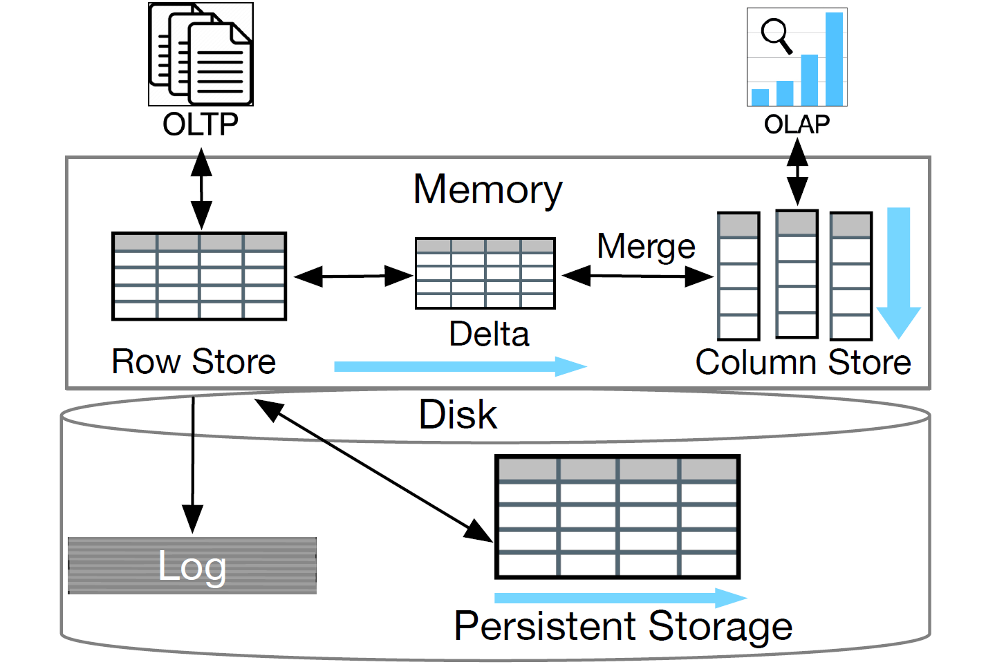
Storage Architectures of HTAP Databases
Primary Row Store + In-Memory Column Store
Source: Guoliang Li and Chao Zhang. 2022. HTAP Databases: What is New and What is Next. (SIGMOD '22)
Notes:
In this architecture, we see an in-memory column store added to the traditional row-store based system, which helps accelerate OLAP queries.

Slide 6
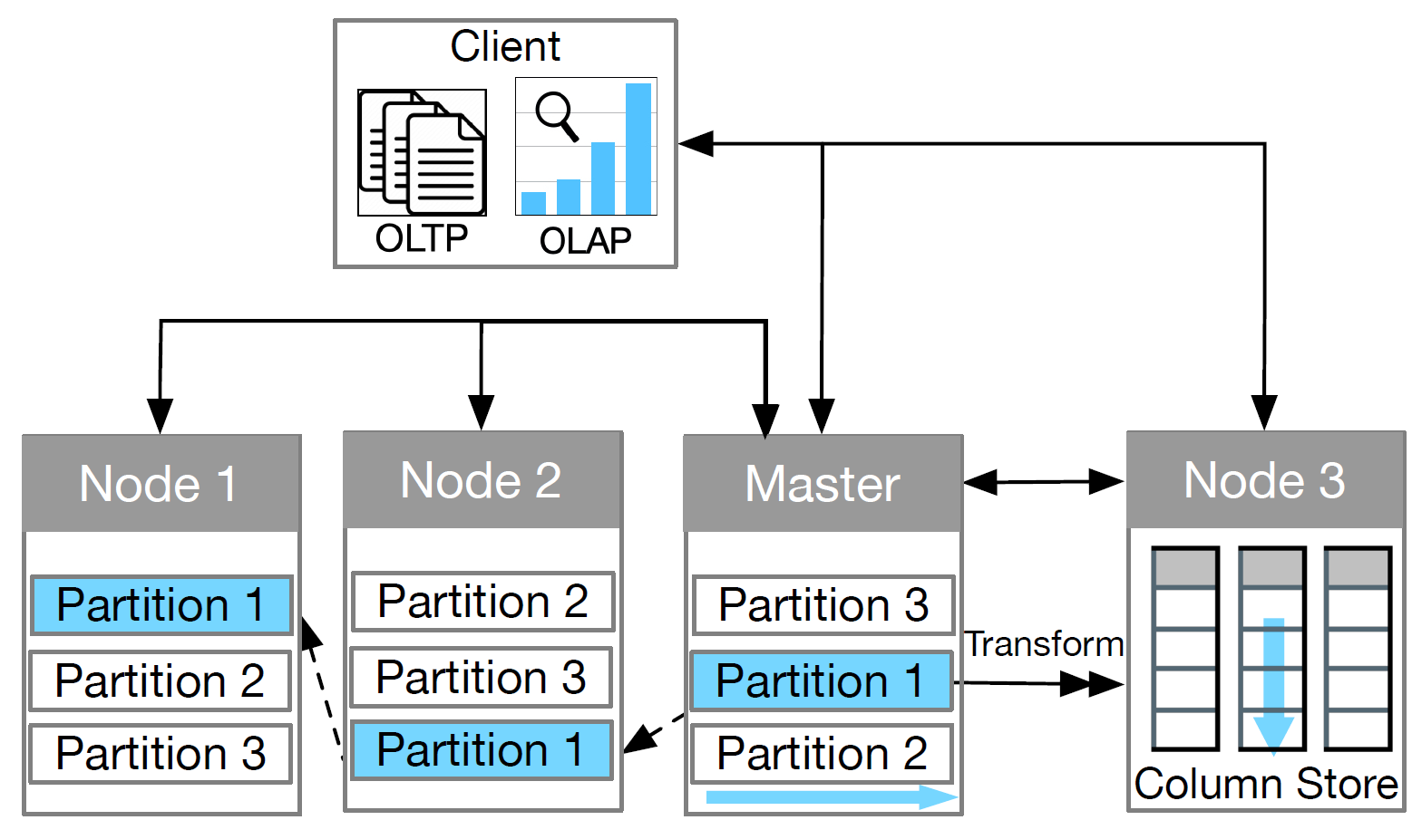
Storage Architectures of HTAP Databases
Distributed Row Store + Column Store Replica
Source: Guoliang Li and Chao Zhang. 2022. HTAP Databases: What is New and What is Next. (SIGMOD '22)
Notes:
In this architecture, we see a Distributed Row Store and a Column Store Replica.
The philosophy here is that ->
1) DML operations touch very few rows at once (hence, partitioning the rows between multiple nodes make sense) Hence, horizontal scaling for the row store
2) Analytics operations use huge number of rows, but very few columns Hence, vertical scaling for the column store

Slide 7
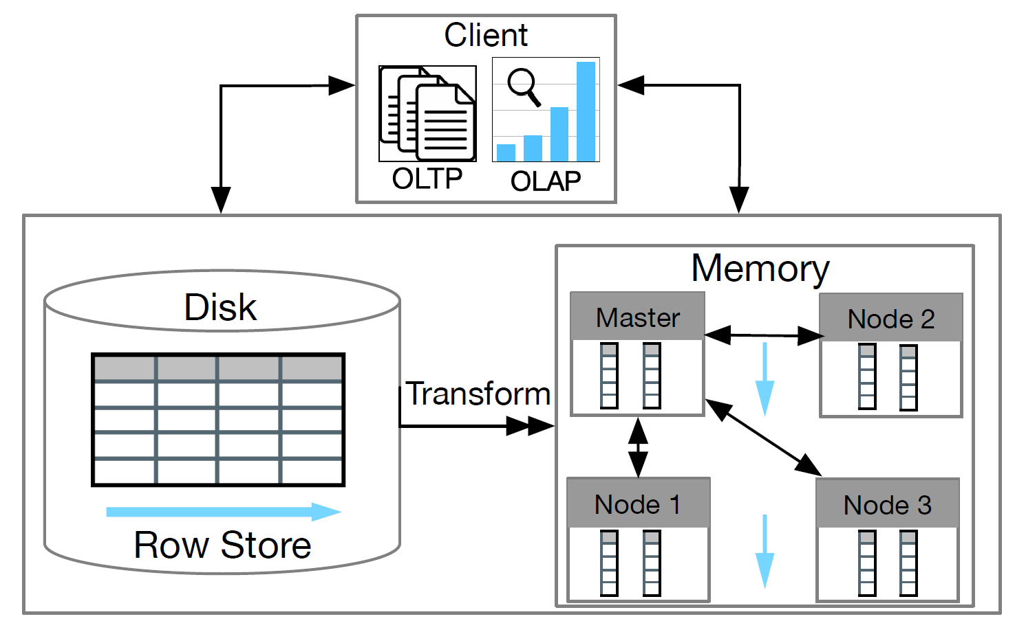
Storage Architectures of HTAP Databases
Disk Row Store + Distributed Column Store
Source: Guoliang Li and Chao Zhang. 2022. HTAP Databases: What is New and What is Next. (SIGMOD '22)
Notes:
In this architecture, we see a Disk Row Store and a Distributed In-Memory Column Store.

Slide 8
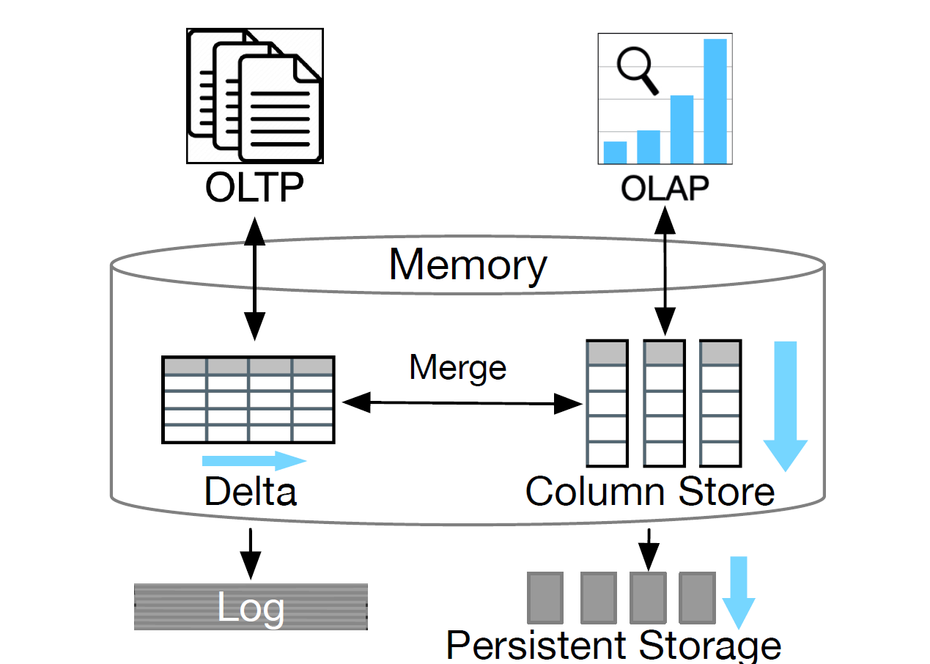
Storage Architectures of HTAP Databases
Primary Column Store + Delta Row Store
Source: Guoliang Li and Chao Zhang. 2022. HTAP Databases: What is New and What is Next. (SIGMOD '22)
Notes:
In this architecture, we see a Primary Column Store and a Delta Row Store.
It buffers the writes in the row wise format and flushes them into the primary column store once a threshold is reached

Slide 9
Oracle Dual Format
Disagg1
Presented by Rwitam Bandyopadhyay
Notes:
We will now look at the first system for today, the Oracle Dual Format In-Memory Database.

Slide 10
Motivation
Oracle introduced the Database In-Memory option in 2014 as the industry’s first dual-format, in-memory RDBMS
No single data format is ideal for all type of workloads
“Primary Row Store + In-Memory Column Store” architectural style
The new columnar format is a pure in-memory format with no impact to the disk representation
Tables required for fast analytics can be populated into the In-Memory column store
Can be plugged in to any existing system with zero changes
Notes:
So, Oracle launched this DB in 2014 as the industry’s first dual format in memory DB.
The motivation behind the design was the fact that no single data format is ideal for all types of workloads.

Slide 11
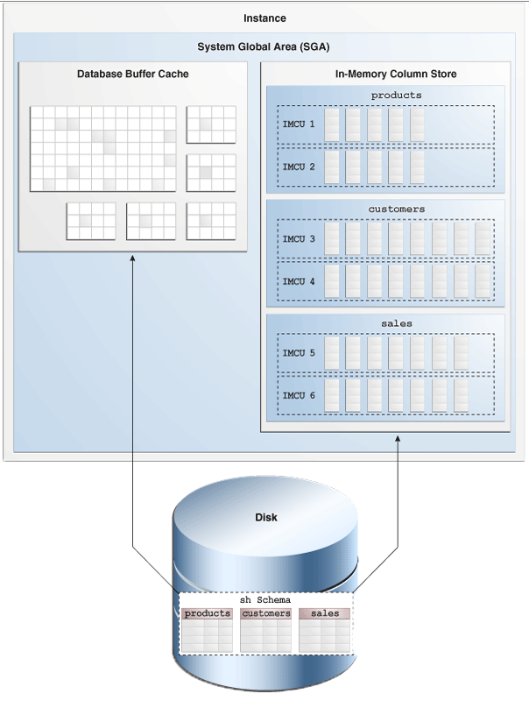
Dual-Format , Dual Memory?
Dual format representation doesn’t double memory requirements!
Tables required for fast analytics → In-Memory Store
OLTP updates/ highly selective lookups → Buffer Cache !
Analytic Indexes can be dropped from the DB
The IM column store is built into the DB data access layer
Source: Oracle Database R21 In-Memory Column Store Architecture
Notes:
1) Tables required for fast analytics can be populated In-Memory
2) OLTP updates and highly selective lookups on the same tables can be performed via the existing in-memory row store, i.e. the buffer cache
3) Since the IM column store can replace analytic indexes, the buffer cache size can be reduced, also speeding up OLTP DML operations by eliminating costly index maintenance
4) The IM column store is built into the data access layer within the database engine and presents the optimizer with an alternate execution method for extremely fast table scans.

Slide 12
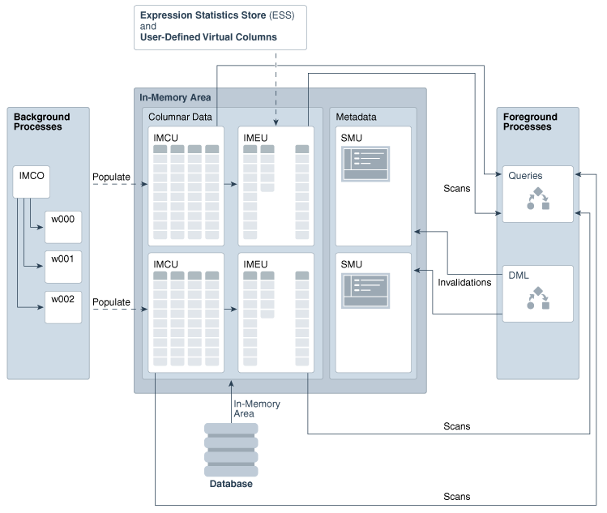
In-Memory Columnar Format (Building Blocks)
In-Memory Coordinator Process (IMCO)
Source: Oracle Database R21 In-Memory Column Store Architecture
Notes:
Because the column store is in-memory only, maintenance of the column store in the presence of DML changes is very efficient, requiring only lightweight in-memory data manipulation
Building Blocks
In-Memory Coordinator Process (IMCO)
In-Memory Compression Units (IMCUs)
In-Memory Expression Units (IMEUs)
Snapshot Metadata Units (SMUs)
These reside in the Shared Global Area (SGA)

Slide 13
In-Memory Columnar Format (Building Blocks)
In-Memory Compression Units (IMCUs)
Source: Oracle Database R21 In-Memory Column Store Architecture
Notes:
Because the column store is in-memory only, maintenance of the column store in the presence of DML changes is very efficient, requiring only lightweight in-memory data manipulation
Building Blocks
In-Memory Coordinator Process (IMCO)
In-Memory Compression Units (IMCUs)
In-Memory Expression Units (IMEUs)
Snapshot Metadata Units (SMUs)
These reside in the Shared Global Area (SGA)

Slide 14
In-Memory Columnar Format (Building Blocks)
In-Memory Expression Units (IMEUs)
Source: Oracle Database R21 In-Memory Column Store Architecture
Notes:
Because the column store is in-memory only, maintenance of the column store in the presence of DML changes is very efficient, requiring only lightweight in-memory data manipulation
Building Blocks
In-Memory Coordinator Process (IMCO)
In-Memory Compression Units (IMCUs)
In-Memory Expression Units (IMEUs)
Snapshot Metadata Units (SMUs)
These reside in the Shared Global Area (SGA)
The Expression Statistics Store (ESS) automatically tracks the results of frequently evaluated (“hot”) expressions.

Slide 15
In-Memory Columnar Format (Building Blocks)
Snapshot Metadata Units (SMUs)
Source: Oracle Database R21 In-Memory Column Store Architecture
Notes:
Because the column store is in-memory only, maintenance of the column store in the presence of DML changes is very efficient, requiring only lightweight in-memory data manipulation
Building Blocks
In-Memory Coordinator Process (IMCO)
In-Memory Compression Units (IMCUs)
In-Memory Expression Units (IMEUs)
Snapshot Metadata Units (SMUs)
These reside in the Shared Global Area (SGA)

Slide 16
In-Memory Columnar Format (Data Population)
It is possible to selectively populate the IM column store with a chosen subset of the database
IM column store is populated using a pool of background server processes
No application downtime during table population since it continues to be accessible via the buffer cache.
Most other in-memory databases require a wait time for all objects to be brought in-memory
Priority | Description
CRITICAL | Object is populated immediately after the database is opened.
HIGH/ MEDIUM/ LOW | Objects are populated after CRITICAL in order of priority.
NONE | Object is only populated after it is scanned for the first time (Default).
Source: T. Lahiri, et al. Oracle Database In-Memory: A Dual Format In-Memory Database. In 2015 IEEE 31st International Conference on Data Engineering
Notes:
The IM column store is populated using a pool of background server processes
There is no application downtime while a table is being populated since it continues to be accessible via the buffer cache
Most other in-memory databases require a wait time for all objects to be brought in-memory

Slide 17
In-Memory Columnar Format (Data Compression)
It is possible to selectively populate the IM column store with a chosen subset of the database
In-memory storage is populated in contiguously allocated units called In-Memory Compression Units.
It is possible to use different compression levels for different partitions within the same table. For example, a SALES table might have →
Current week partition - DML Compression
Earlier year partitions - Query Compression
Decade old partitions - Capacity Compression
MEMCOMPRESS | Description
DML | Minimal compression optimized for DML Performance
QUERY LOW/HIGH | Optimized for fastest query performance (Default)
CAPACITY LOW/HIGH | Optimized for space saving
Source: T. Lahiri, et al. Oracle Database In-Memory: A Dual Format In-Memory Database. In 2015 IEEE 31st International Conference on Data Engineering
Notes:
Since we store homogeneous data in each column, column stores can often utilize compression to save space.
The Oracle Dual-Format DB offers multiple compression strategies which can be configured as per the use case.

Slide 18
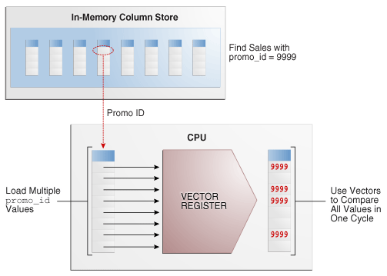
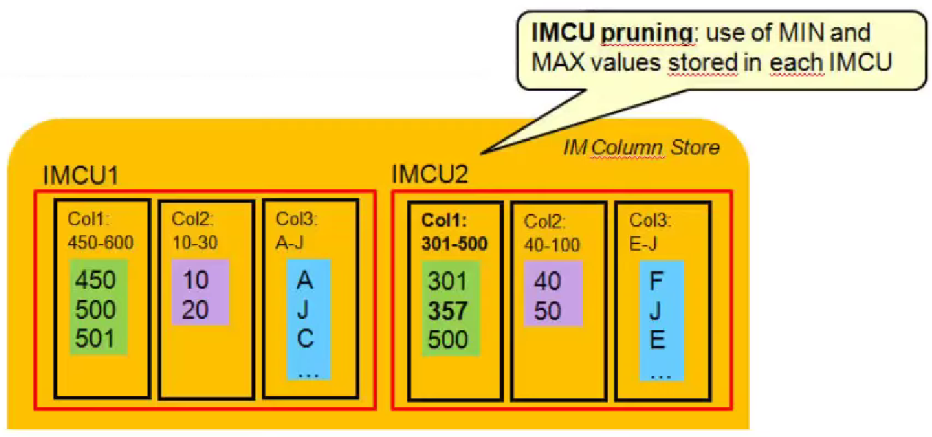
Query Processing
In-Memory Scans utilize SIMD Vector Processing
In-Memory Storage Indexes are automatically created and maintained on each of the columns.
These allow data pruning to occur based on the filter predicates supplied in a SQL statement.
Source: Oracle Database R21 In-Memory Column Store Architecture
Notes:
The In-Memory Data is taken advantage of to provide scan rates exceeding billions of rows/sec per CPU core.
In-memory scans utilize SIMD instructions to process multiple operands in a single CPU instruction, for example, finding the occurrences of a value in a set of values.
Each IMCU also creates sparse indexes to keep a track of value ranges in each IMCU. This can help prune out irrelevant IMCUs during scans if filter predicates are specified in the query.

Slide 19
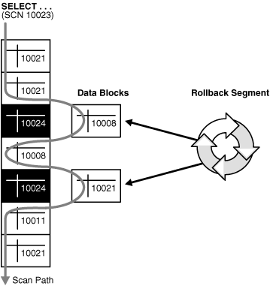

Transactional Consistency
The default isolation level of Oracle DB is “Consistent Read”
As a query enters the execution stage, the current system change number (SCN) is determined.
Each query returns all committed data with respect to the SCN recorded at the time that query execution began.
The In-memory Column store follows similar semantics!
Source: Oracle Database Concepts 10g - Data Concurrency and Consistency
Notes:
Oracle DBs offer consistent read, which means that the data returned by a query is committed and consistent with respect to a single point in time.
They do that by using System Change Numbers at each point of time, and each query returns all the committed data wrt to the SCN.

Slide 20
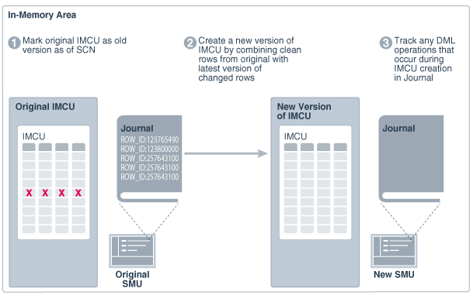
Transactional Consistency (Double Buffering)
Source: Oracle Database R21 In-Memory Optimizing Repopulation of the IM Column Store
Notes:
In double buffering, background processes create new IMCU versions by combining the original rows with the latest modified rows.
The basic steps of double buffering are:
In the original SMU, the database marks the existing IMCU as the original version as of a specific SCN.
Background processes create a new version of the IMCU by combining the original rows with the latest versions of the modified rows.
In the journal of the new SMU, the database tracks DML operations that occur during IMCU creation.

Slide 21
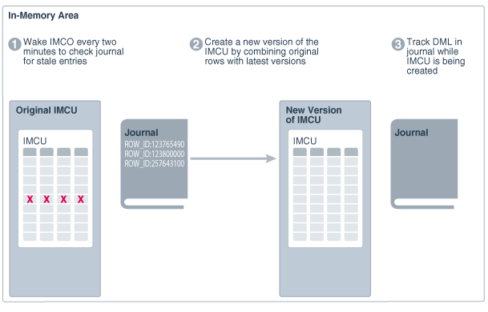
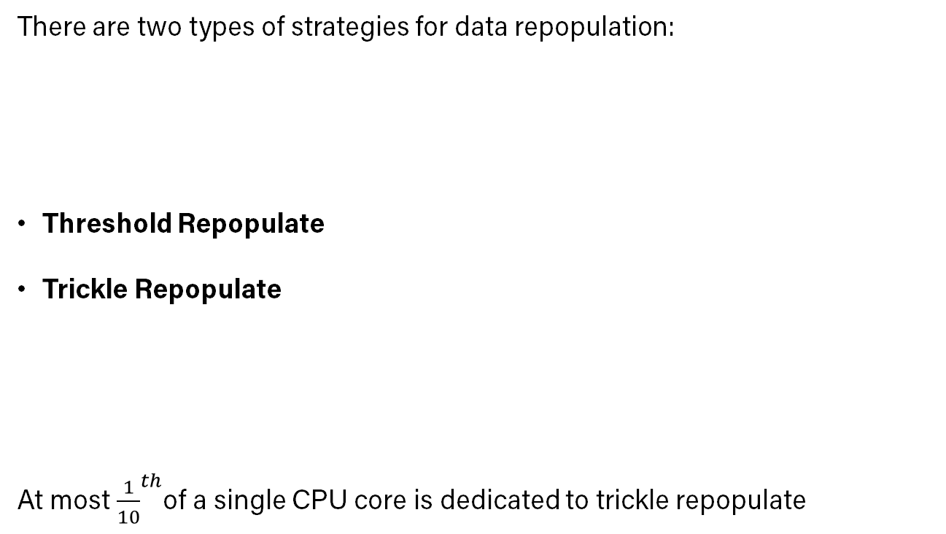
Transactional Consistency (Repopulation Overhead)
There are two types of strategies for data repopulation:
Threshold Repopulate
Trickle Repopulate
At most ${\frac{1}{10}}^{th}$of a single CPU core is dedicated to trickle repopulate
Source: Oracle Database R21 In-Memory Optimizing Repopulation of the IM Column Store
Notes:
As more changes occur, fetching data from the transaction journal causes overhead for scans
There are two types of strategies for data repopulation:
Threshold Repopulate - This form depends on the percentage of stale entries in the transaction journal for an IMCU.
Trickle Repopulate - This form supplements threshold-based repopulation by periodically refreshing columnar data even when the staleness threshold has not been reached.
At most ${\frac{1}{10}}^{th}$of a single CPU core is dedicated to trickle repopulate

Slide 22
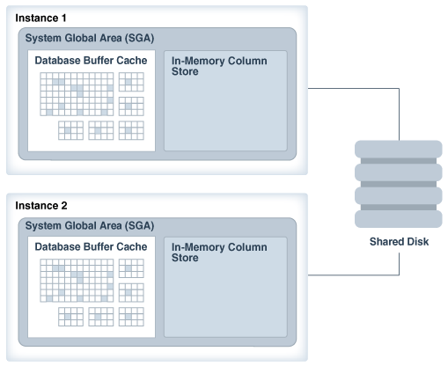
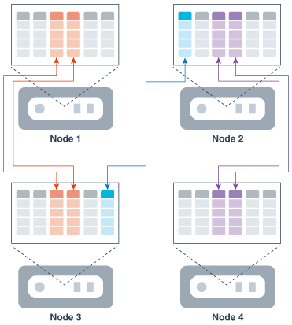
In-Memory Column Store Scale Out
Distribution
Duplication
Source: Oracle Database R21 In-Memory Deploying IM Column Stores in Oracle RAC
Notes:
In-Memory can scale out across multiple machines using the Oracle Real Application Cluster configuration

Slide 23
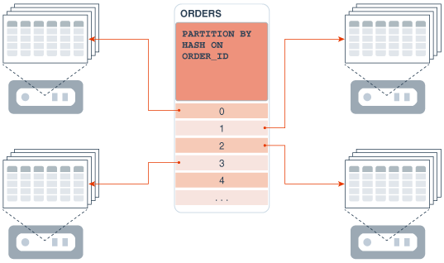
In-Memory Column Store Scale Out (Distribution)
Distributing Partitions by Hash
Source: Oracle Database R21 In-Memory Deploying IM Column Stores in Oracle RAC
Notes:
In-Memory can scale out across multiple machines using the Oracle Real Application Cluster configuration

Slide 24
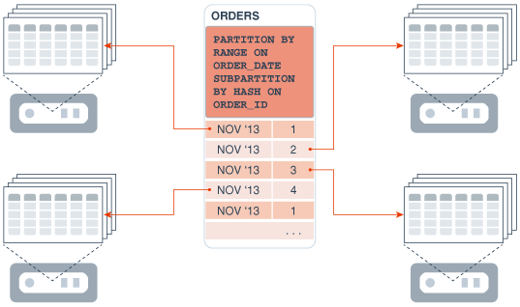
In-Memory Column Store Scale Out (Distribution)
Distributing Partitions by Range and Sub partitions by Hash
Source: Oracle Database R21 In-Memory Deploying IM Column Stores in Oracle RAC
Notes:
In-Memory can scale out across multiple machines using the Oracle Real Application Cluster configuration

Slide 25
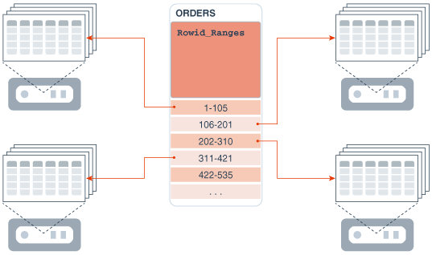
In-Memory Column Store Scale Out (Distribution)
Distribution by Rowid Range
Source: Oracle Database R21 In-Memory Deploying IM Column Stores in Oracle RAC
Notes:
In-Memory can scale out across multiple machines using the Oracle Real Application Cluster configuration

Slide 26
Handling Node Failures
If an Oracle RAC instance fails, then the IMCUs on the failed instance are unavailable.
Consequently, a query that needs data stored in the inaccessible IMCUs must read it from somewhere else: the database buffer cache, flash storage, disk, or mirrored IMCUs in other IM column stores.
Duplication helps to provide fault tolerance because if one node fails, then the mirrored columnar data is accessible from a different node.
Worst case, queries issued against missing data do not fail. Instead, queries access the data either from the database buffer cache or permanent storage, which may just negatively affect performance.
Source: Oracle Database R21 In-Memory Deploying IM Column Stores in Oracle RAC
Notes:
In-Memory can scale out across multiple machines using the Oracle Real Application Cluster configuration

Slide 27
SAP HANA
Disagg1
Presented by
Shubham Pandey

Slide 28
SAP HANA
Architecture
Application
Writes
Reads
Reads
SQL Processor
SQL Processor
Replication Log Generator
ATR
Replication Log Replayer
In-Memory DB
In-Memory DB
Primary
Secondary
Recovery logs
Recovery logs
Source: http://www.vldb.org/pvldb/vol10/p1598-han.pdf
Notes:
<HANA – high performance analytics appliance>
It was developed in 2010 by SAP with the objective to provide near-real-time analytics and HANA is short for high performance analytics appliance.
today I would be talking about a subset of design decisions that make this system so powerful in analytical queries.
This is based on the idea that the Primary machine supports OLTP workloads while the OLAP workloads are supported in replicas. Lets take a look at it from the outside. <explain the animation>
This replication mechanism in SAP hana is called ATR which is short for asynchronous parallel table replication.

Slide 29
SAP Hana
Design Decisions
In-Database Replication
Incoming Write
SQL Processor
Replication log generator
In-Memory DB
Replication Log Sender
Primary
Source: http://www.vldb.org/pvldb/vol10/p1598-han.pdf
Notes:
The replication log generator and sender are embedded inside the DB engine instead of relying on the external application to avoid any network roundtrip.

Slide 30
SAP Hana
Design Decisions
Asynchronous Replication
Incoming Write
SQL Processor
Replication log generator
In-Memory DB
Replication Log Sender
Replication Log Replayer
Primary
Secondary
Source: http://www.vldb.org/pvldb/vol10/p1598-han.pdf
Notes:
It allows the transaction to commit without waiting for its replication log propagation to the replicas. This means the client is going to receive the ack as soon as the commit has happened at the primary.

Slide 31
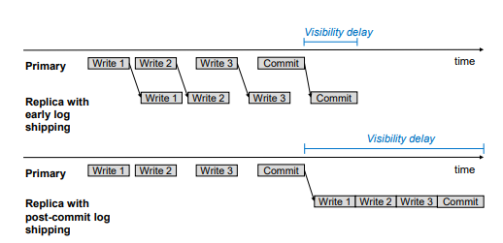
SAP Hana
Design Decisions
Early Log Shipping
Source: http://www.vldb.org/pvldb/vol10/p1598-han.pdf
Notes:
For a transaction involving three writes, it would allow the logs to be shipped before even the transaction has committed which is an optimistic way of dealing with it.

Slide 32
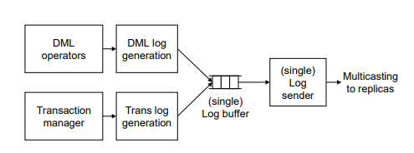
SAP Hana
Design Decisions
Log generator and Sender
Source: http://www.vldb.org/pvldb/vol10/p1598-han.pdf
Notes:
Looking at the side of the primary node, successful execution of DML, the log is generated and appended to the log buffer. Note that there can be multiple threads trying to write onto the buffer, but writes to it can be efficiently implemented using compare and swap atomic operation.
A single log buffer ensures that transaction log entries are placed after their DML log entries, and also a later transaction’s commit log is placed after its earlier committed transaction.

Slide 33
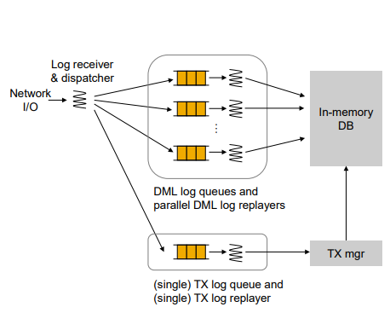
SAP Hana
Design Decisions
Parallel Log Replay
session_id % n
Source: http://www.vldb.org/pvldb/vol10/p1598-han.pdf
Notes:
Since SAP hana is typically deployed to shared-memory multiprocessor architecture, the replication log entries can be generated from multiple CPU cores at primary. Which means that there has to be a way for secondary nodes to keep up with that speed.
Lets take a look at the other side, which is at the replica, where we have the log receiver and dispatcher. If the log entry is commit log, it is sent to TX queue otherwise it is sent to DML queue. Since there are multiple DML queues, the decision on which DML queue to send the log entry to is based hash of the session ID. Since the whole transaction is bound to a single session, it makes sure that log entries from that transaction reside in same queue. Also for a session that is likely to use same of objects, unnecessary conflicts are reduced. Note that the tableId based distribution is not used because it may limit the parallelism in case of skewed update workloads.

Slide 34
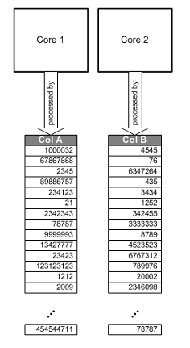
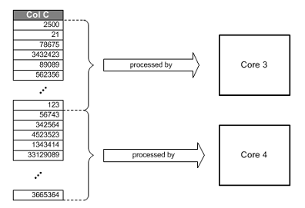
SAP Hana
Parallel Processing
Source: https://help.sap.com/docs/SAP_HANA_PLATFORM
Notes:
Everything that I talked about up until now was to minimize visibility delay, but what about the time taken to process the analytical queries?

Slide 35
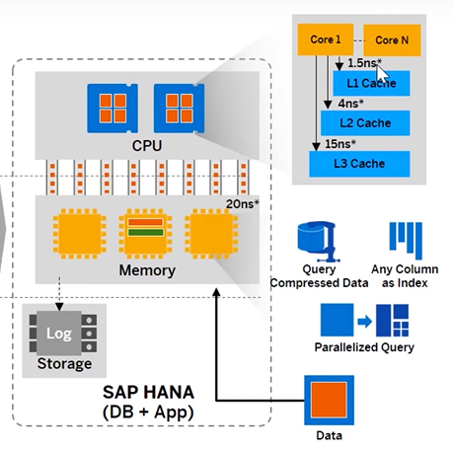
SAP Hana
Exploiting Modern Hardware
Source: https://www.youtube.com/watch?v=ljdvqRtSHd4
Notes:
If we zoom out a bit and look at how SAP hana exploits all the modern hardware, you would see that first, all the data resides in memory. Compressed data can be loaded into CPU cache much faster and it more than outweighs the performance hit for decompression. Second, is the multiple CPU cores that allow exploiting the scope of parallelism. Also, it does not store the precomputed aggregates, and this is done on the fly for SAP hana, this ensures the freshness of the data also that we don’t have to generate aggregates after each write operation.

Slide 36
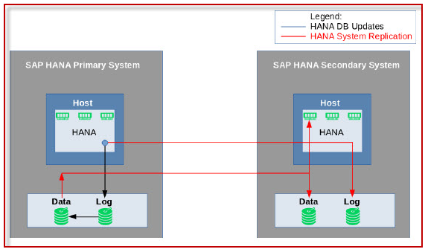
SAP Hana
Fault Tolerance
Continuous synchronization of HANA DB to secondary location
Secondary location can be in same data center or a different one
Source: https://blogs.sap.com/2021/12/31/sap-hana-platform-fault-tolerance-features-high-availability/
Notes:
If we zoom out a bit and look at how SAP hana exploits all the modern hardware, you would see that first, all the data resides in memory. Compressed data can be loaded into CPU cache much faster and it more than outweighs the performance hit for decompression. Second, is the multiple CPU cores that allow exploiting the scope of parallelism. Also, it does not store the precomputed aggregates, and this is done on the fly for SAP hana, this ensures the freshness of the data also that we don’t have to generate aggregates after each write operation.

Slide 37
TiDB: A Raft Based HTAP Database
Disagg1
Presented by
Satya Sai Bharath Vemula

Slide 38
System Goals
System on Higher Level
Provide Isolation for OLTP and OLAP Queries
Providing separate data stores (Row-based and Column-based) for OLTP and OLAP
Providing Consistent View of Data / Real time data synchronization between the two data stores by extending using state machine-based consensus algorithm (RAFT)
Highly Scalable and Available System with efficient query processing
Source: Guoliang Li and Chao Zhang. 2022. HTAP Databases: What is New and What is Next. (SIGMOD '22)
Notes:
As noted earlier to

Slide 39
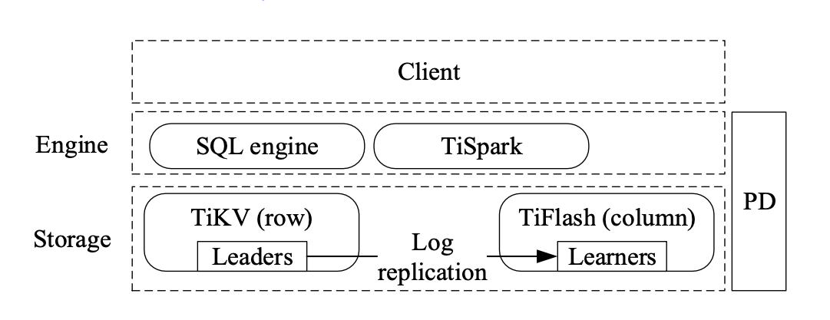
TiDB Architecture
Source: https://www.vldb.org/pvldb/vol13/p3072-huang.pdf
Notes:
Explain about
3 Components What is TiKv , TiFlash and Placement Driver
Placemnet Driver
Very crucial for the system
This part is responsible for issuing logical timestamps for transactions so that incrementing (which is key for two phase commit will be explained in the later parts).
Monitor and issue merge / split commands top regions
storing the meta data about the data regions
We have two query engines
1. SQL Query Engine operating on both TiKv and TiFlash Nodes
TiSpark is special for analytical queries

Slide 40
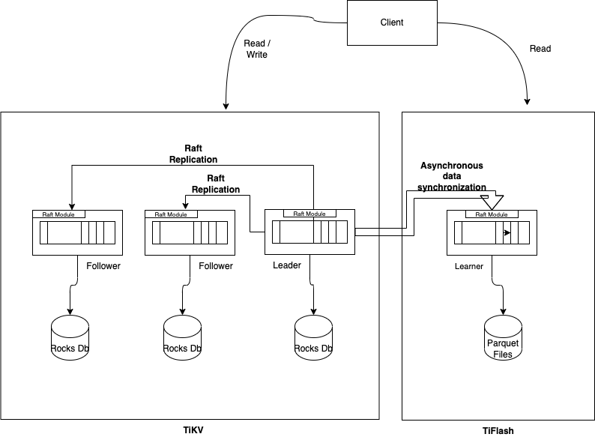
TiDB Raft
Source: https://www.vldb.org/pvldb/vol13/p3072-huang.pdf
Notes:
Explain about
Raft (Consensus algorithm which is proven to )
Leader and Follower
2m+1 and m+1 nodes logic (Availability)
Characteristics of Raft
Consistent System / Linearizable System
In a
Explain that base Raft nodes is only used for Row based store
Leaner uses columnar store
Addition of new role called Learner to for the Raft Replication (they claim having a this way of asynchronus replication mechanism is light weight and keep the system almost consistent)
We will see the

Slide 41
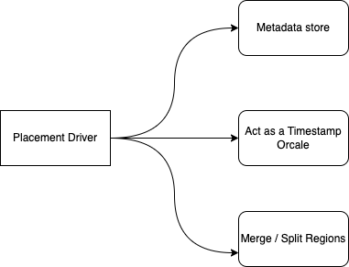
Placement Driver

Slide 42
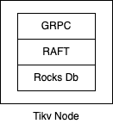
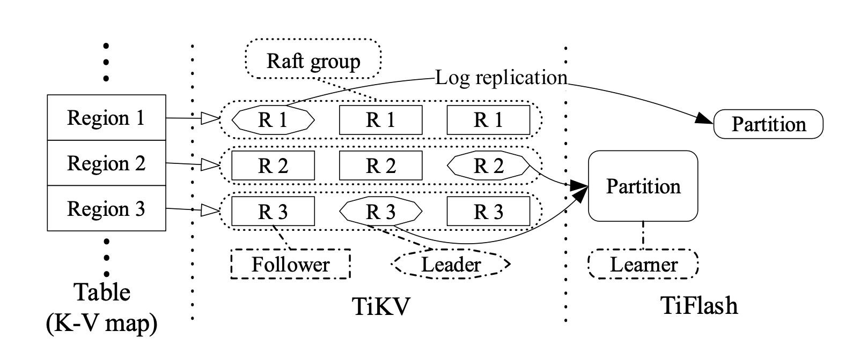
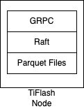
TiDB Scaling
Notes:
Points to mention here
Each Tikv Node is either a Leader / Follower in Raft Storage System hosting
What each Tikv node and TiFlash Node is made of the layers
Also mention they say the format is similar to Parquet (Not the exact thingy)
Introduce the concept of Regions similar to sharding
Just mention the shards could be merged or split based on workload
And placement drive is responsible for this mechanism
Lastly mention regarding what each partition is and that multiple regions can be mapped to single TiFlash Node

Slide 43
Availability / Failure Tolerance
Failure Tolerance in both TikV and TiFlash is maintained through replicas
For each TiKV region if there are 2*m + 1 nodes there will be no observed down time if m + 1 nodes are functional in the same network partition.
This Property is because of RAFT Availability Semantics
OLTP queries for a region will not be functional if more than m + 1 nodes in a region have failed.
TiFlash supports multiple replicas for the same data
If there are N replicas for a single TiFlash Node, The system can bear a failure of N –1 replicas
OLAP queries can still be functional if all the TiFlash Nodes are down as the system can also read data from TiKV nodes for serving analytical queries.

Slide 44
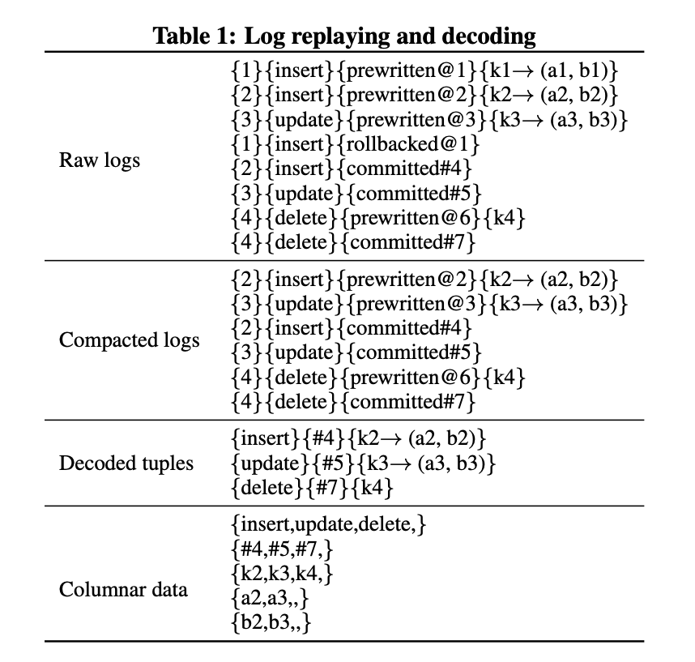
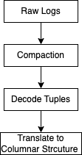
Log Replay
Source: https://www.vldb.org/pvldb/vol13/p3072-huang.pdf
Notes:
Introduce the concept of what logs will be storing
mention regarding different stages of two commit are translated into Raft logs
And once the batch of logs are pulled are got into Leaner node
It goes through the process of compaction, decoding tuples and converting them into columnar data
The batch of logs which are inserted into delta tree (B+ tress which helps in avoiding read amplification)
The deltas are merged into Main space in a periodic manner

Slide 45
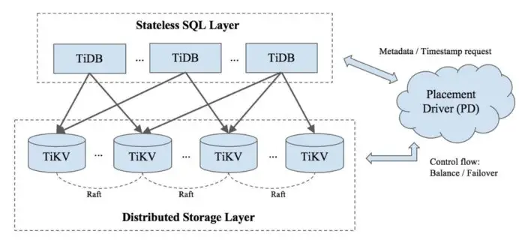
OLTP Query Processing

Slide 46
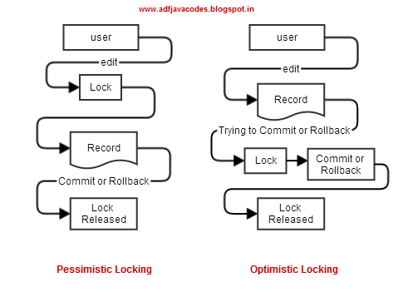
OLTP Distributed Transaction
Source: https://adfjavacodes.blogspot.com/2014/05/adf-locking-mechanism-in-adf-find-out.html

Slide 47
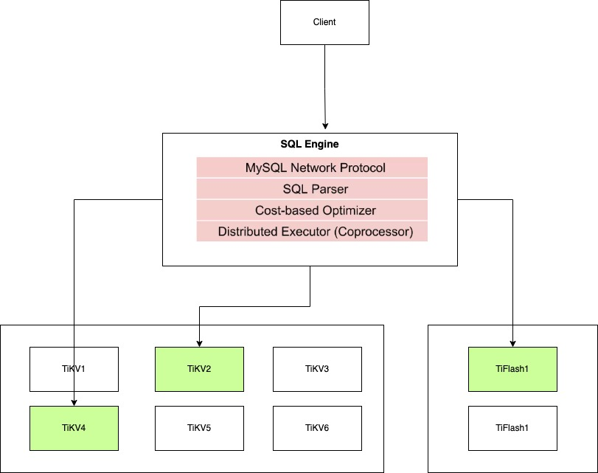
OLAP Query Processing
Source: https://www.vldb.org/pvldb/vol13/p3072-huang.pdf
Notes:
Things to mention here
What is RBO and CBO
How indexes are stored in TiDb
The Concept of co-processors
The equation for cost planning of query

Slide 48
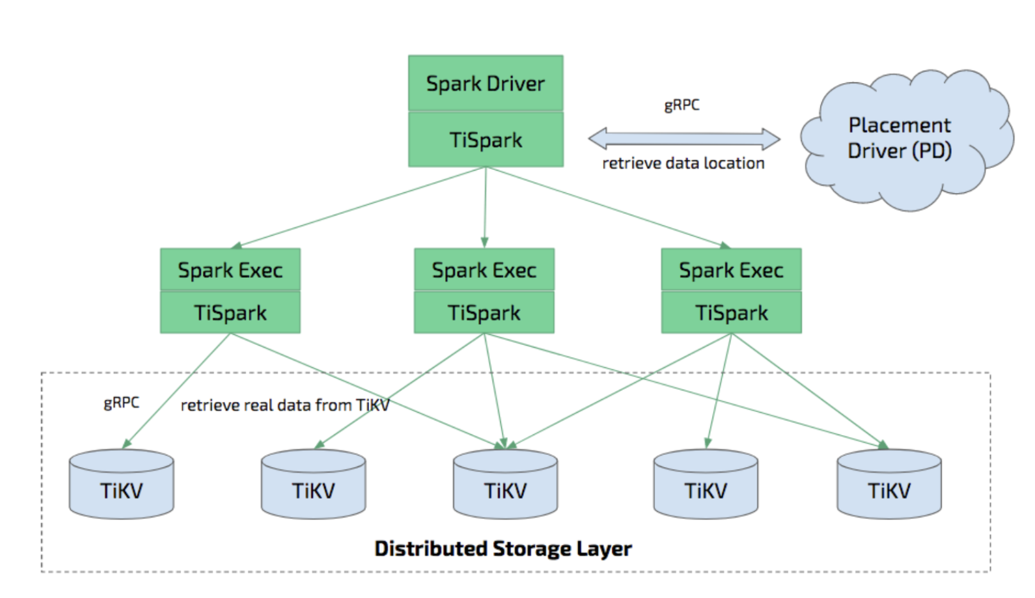
TiDB TiSpark
Source: https://docs.pingcap.com/tidb/dev/tispark-overview

Slide 49
Project Plan
Study HTAP systems with diverse architectures (e.g. data organisation and synchronization)
Compare and Contrast such systems based on their design decisions
Assess the strengths and weakness of these systems (in terms of AP/TP throughput, scalability, among others)
Study the systems that have evolved from OLTP to HTAP (e.g. MemSQL, IBM dashDB, and more)
Notes:
Snowflake unistore
polarDB
AlloyDB

Slide 50
Appendix Detailed Description

Slide 51
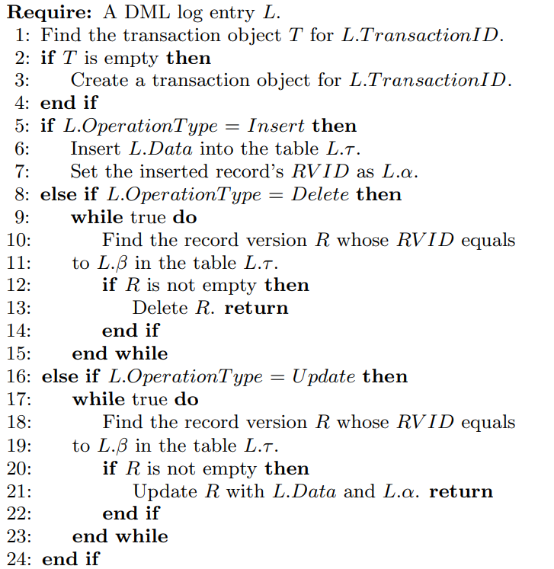
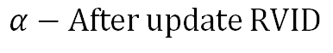
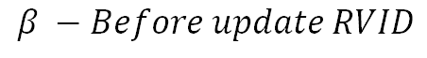
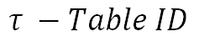
SAP Hana
Replay Algorithms – DML log entry
$$τ −Table ID$$
$$β −Before update RVID$$
$$α−After update RVID$$
Source: http://www.vldb.org/pvldb/vol10/p1598-han.pdf

Slide 52
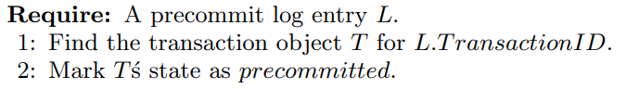
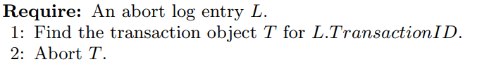
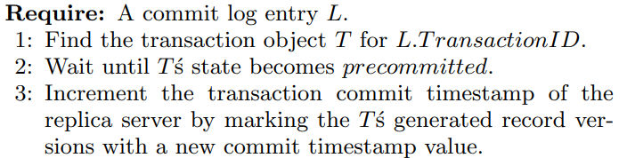
SAP Hana
Replay Algorithms
Replay a precommit log entry
Replay an abort log entry
Replay a commit log entry
Source: http://www.vldb.org/pvldb/vol10/p1598-han.pdf

Slide 53
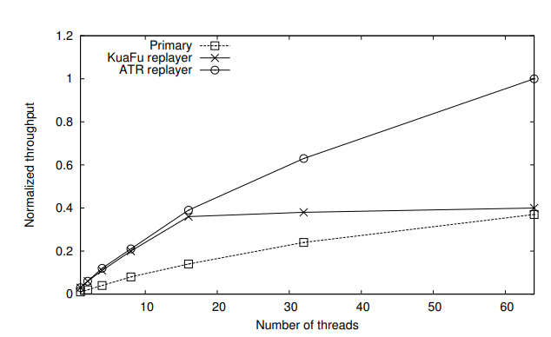
SAP Hana
Multi-core Scalability with Parallel Log Replay
TPC-C benchmark
Source: http://www.vldb.org/pvldb/vol10/p1598-han.pdf

Slide 54
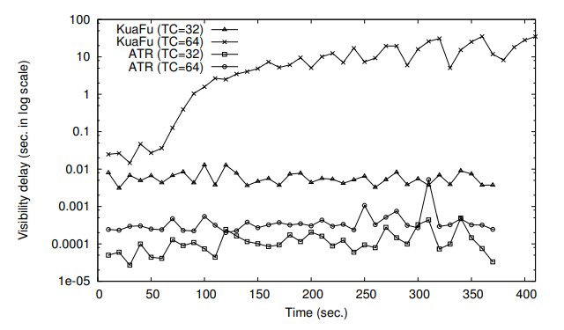
SAP Hana
Visibility Delay
Visibility delay at replica while running TPC-C benchmark at primary
Source: http://www.vldb.org/pvldb/vol10/p1598-han.pdf

Slide 55
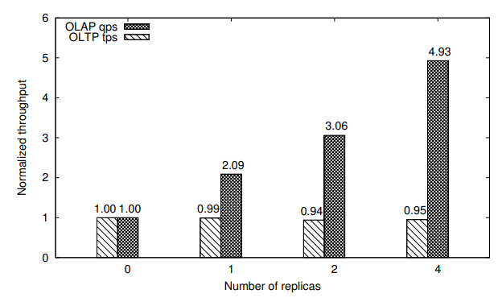
SAP Hana
Multi Replica scalability under mixed (OLTP+OLAP) workload
Source: http://www.vldb.org/pvldb/vol10/p1598-han.pdf

Slide 56
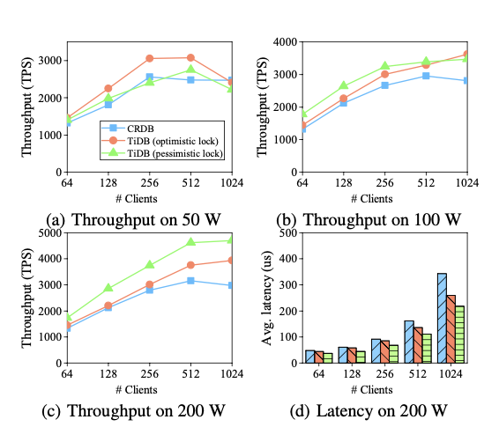
TiDb OLTP Performance Comparison
Source: https://www.geeksforgeeks.org/three-phase-commit-protocol/
Notes:
They have compared the results in contrast to cockroach Db which is a OLTP database which support highly scalable SQL and built using

Slide 57
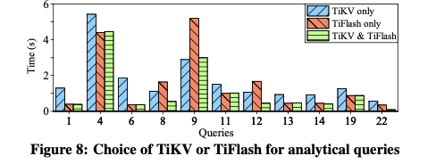
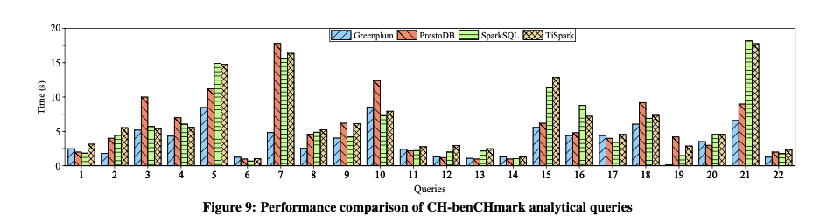
OLAP Performance
Source: https://www.vldb.org/pvldb/vol13/p3072-huang.pdf
Notes:
For Measuring the OLAP Performance they have used TPC-H benchmark which constituted of 22 queries
TiFlash vs Tikv vs both
SparkSQL and TiSpark

Slide 58
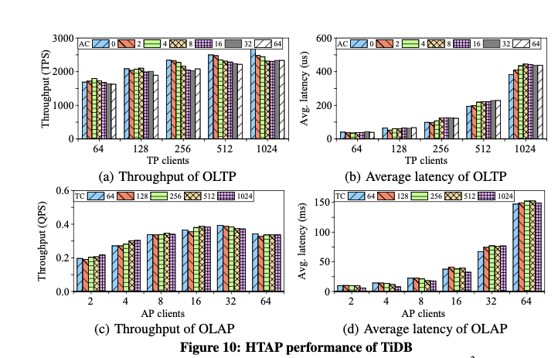
HTAP Performance Results
Source: https://www.vldb.org/pvldb/vol13/p3072-huang.pdf

Slide 59

Raft Learner
Source: https://assets.ctfassets.net/oxjq45e8ilak/1N3hH0IB4uDWS9zrcMaNA3/5fbd6c5db4835b022202a385505625b2/TiDB-EdHuang.pdf

Slide 60

TiKV Table Storage
Source: https://www.slideshare.net/morgo/tidb-introduction

Slide 61


Appendix (OLAP Optimization)
Source: https://www.vldb.org/pvldb/vol13/p3072-huang.pdf

Slide 62


Appendix (Cost Modeling)
Source: https://www.vldb.org/pvldb/vol13/p3072-huang.pdf

Slide 63

Appendix (General Two-Phase Commit)
Source: https://www.geeksforgeeks.org/three-phase-commit-protocol/

Slide 64

Appendix (TiDB Two-Phase Commit)

